Slide 1
@fye.selfcare
One English class’s effort to spread self love, self care, and positivity to peers.

Slide 2
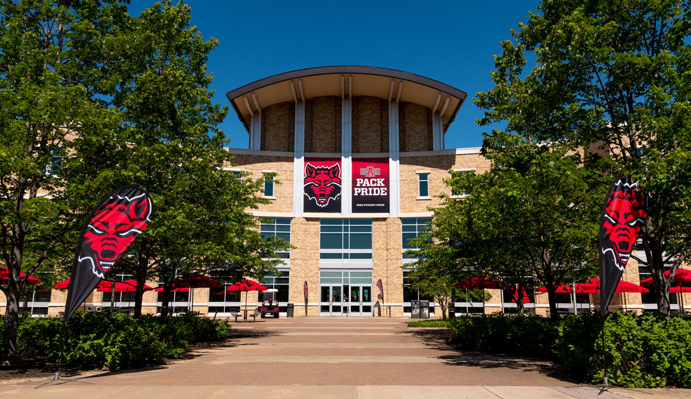
The Goal
The purpose of our project was to ensure that the members of campus know of helpful resources to seek out help, and to share ideas of how other individuals cope while stressed, especially in the midst of a pandemic.

Slide 3
The Steps
Create a social media page that each member could access.
Spread the word about the page.
Invite people to share their experiences and how they practice self care.
Share the tips sent in by students to give others ideas.
Connect to the ASU campus so that students will realize they should take care of themselves in such challenging times.

Slide 4
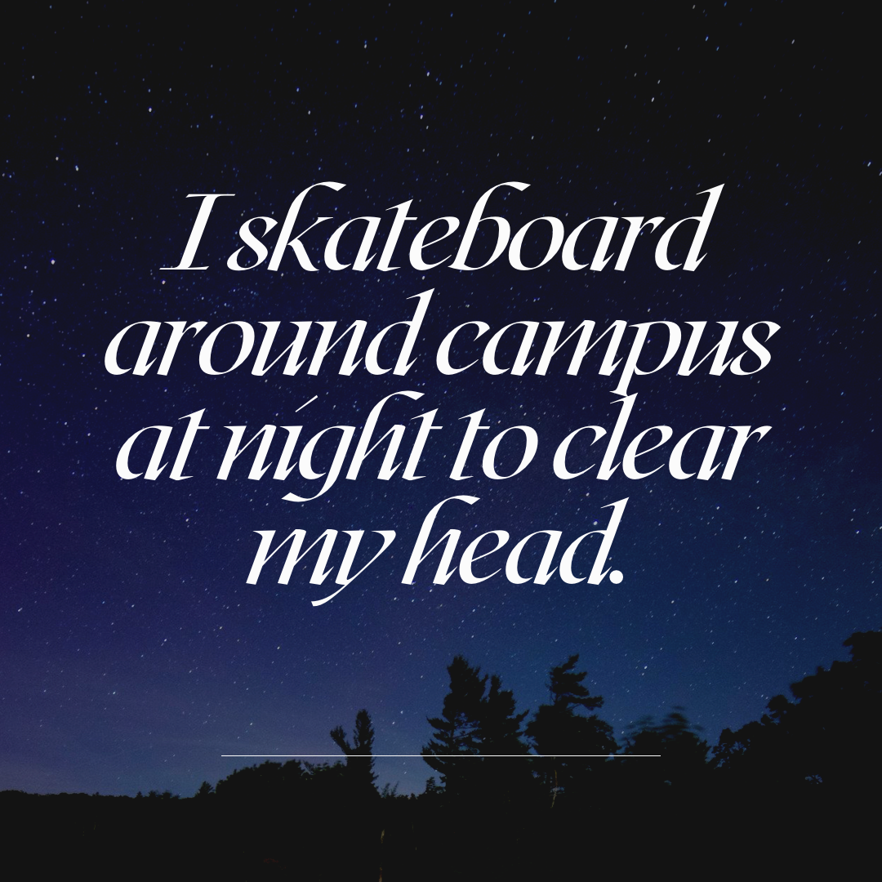
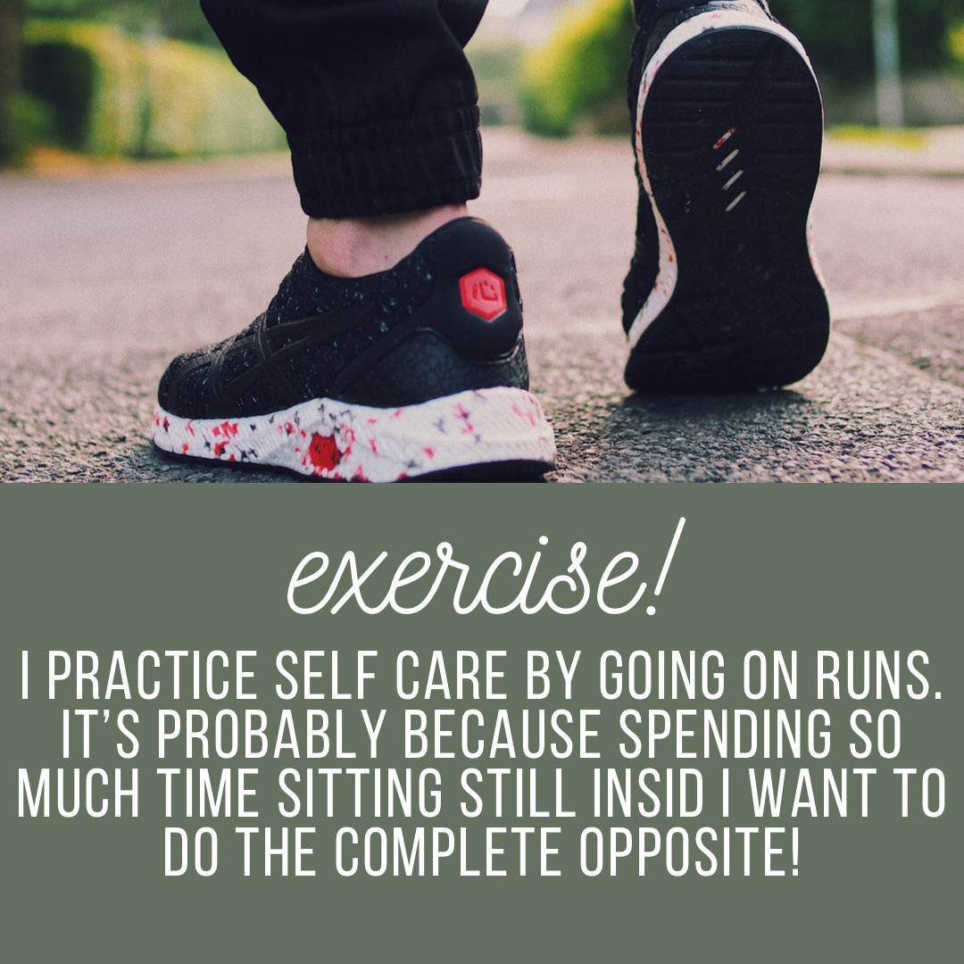

Slide 5
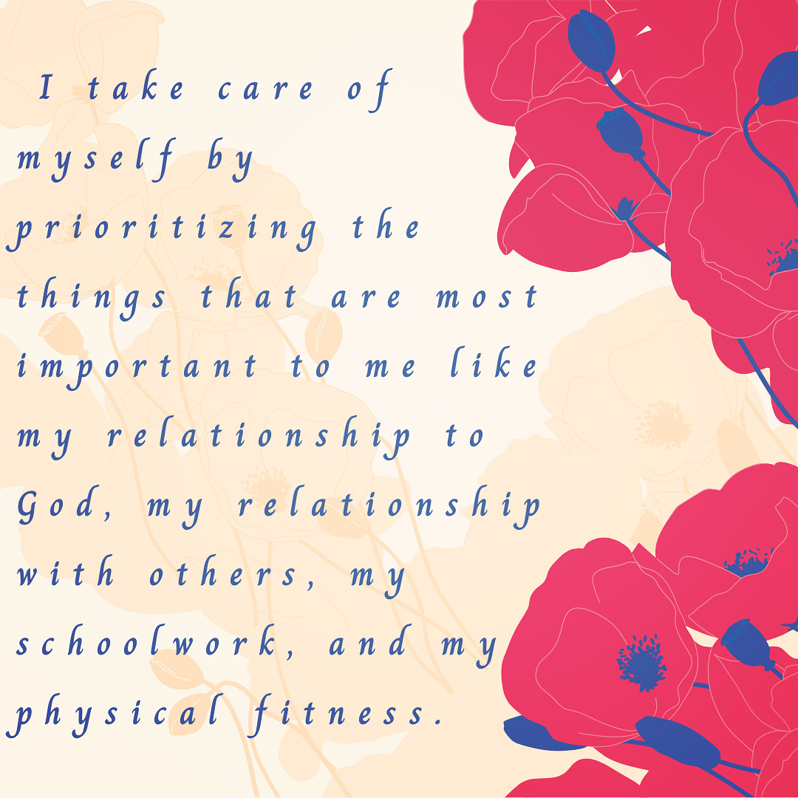
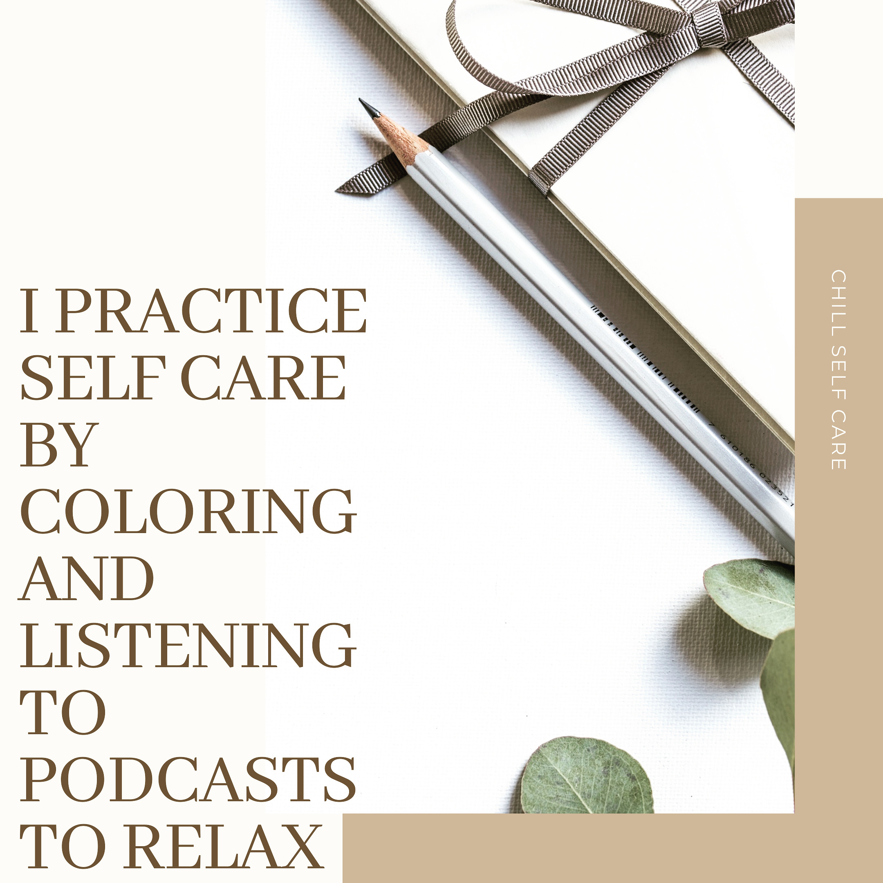
Posts

Slide 6
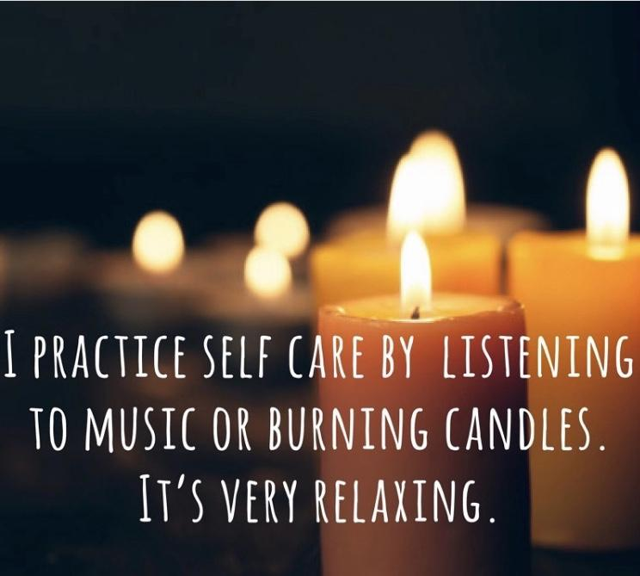

Slide 7
Conclusion
We hope that, in a small way, this project connected different ASU students. We only had a limited amount of time, but we learned that self care takes many different forms. Hopefully, students realize they need to take care of themselves, especially in the challenges we have faced during this year.

Slide 8
Completed by Carlie Glass, Madison Symons, Isabel Fodor, and Jack Nibblett under the guidance of
Dr. Carmen Lanos Williams

